Slide 1
HIST 111: United States History to 1865
Third Review Powerpoint

Slide 2
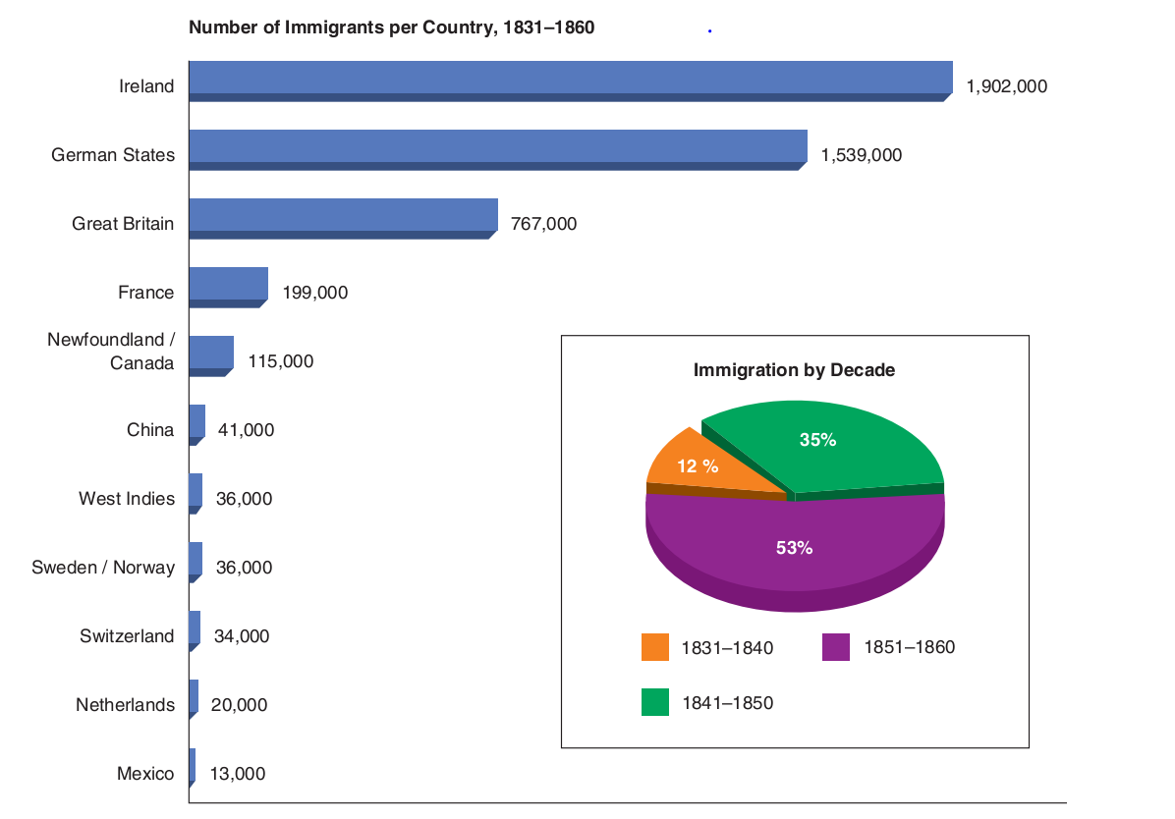
Review
Explain the statement that “the North transformed from a society with markets to a market society.”
In the colonial era, settlers lived in a society in which they engaged in long-distance trade— selling their surpluses to merchants, who in turn sent raw materials to Europe, using the proceeds to purchase finished goods for resale—but in which most settlers remained self-sufficient. During and after the War of 1812, the North became a market society in which participation in long-distance commerce altered individuals’ aspirations and activities.
What factors inspired immigration from Europe into the Northern United States?
Various factors “pushed” Europeans from their homes and “pulled” them to the northern United States. In Ireland, the potato famine (1845–1850)—a period of widespread starvation caused by a diseased potato crop—drove millions from their homeland. Although economic conditions pushed most Germans, some were political refugees—liberals, freethinkers, socialists, communists, and anarchists—who fled after the abortive revolutions of 1848. Employers, states, and shipping companies promoted opportunities in America with this message: work and prosper in America or starve in Europe.
Treatise on Domestic Economy
In her widely read Treatise on Domestic Economy (1841), Catharine Beecher approached housekeeping as a science while trumpeting mothers’ role as their family’s moral guardian. The home became, in theory, an emotional retreat from the competitive, selfish business world. Men provided and protected, while women nurtured and guarded the family’s morality. Childhood expanded: children were to remain at home until their late teens or early twenties.
This ideal became known as separate-spheres ideology, the cult of domesticity, or the cult of true womanhood. Although it rigidly separated the male and female spheres, this ideology elevated domestic responsibilities.
Most immigrants came from two areas: Great Britain, of which Ireland was a part, and the German states. These two areas sent more immigrants between 1830 and 1860 than the inhabitants of the United States enumerated at the first census in 1790. By 1860, 15% of the white population was of foreign birth

Slide 3
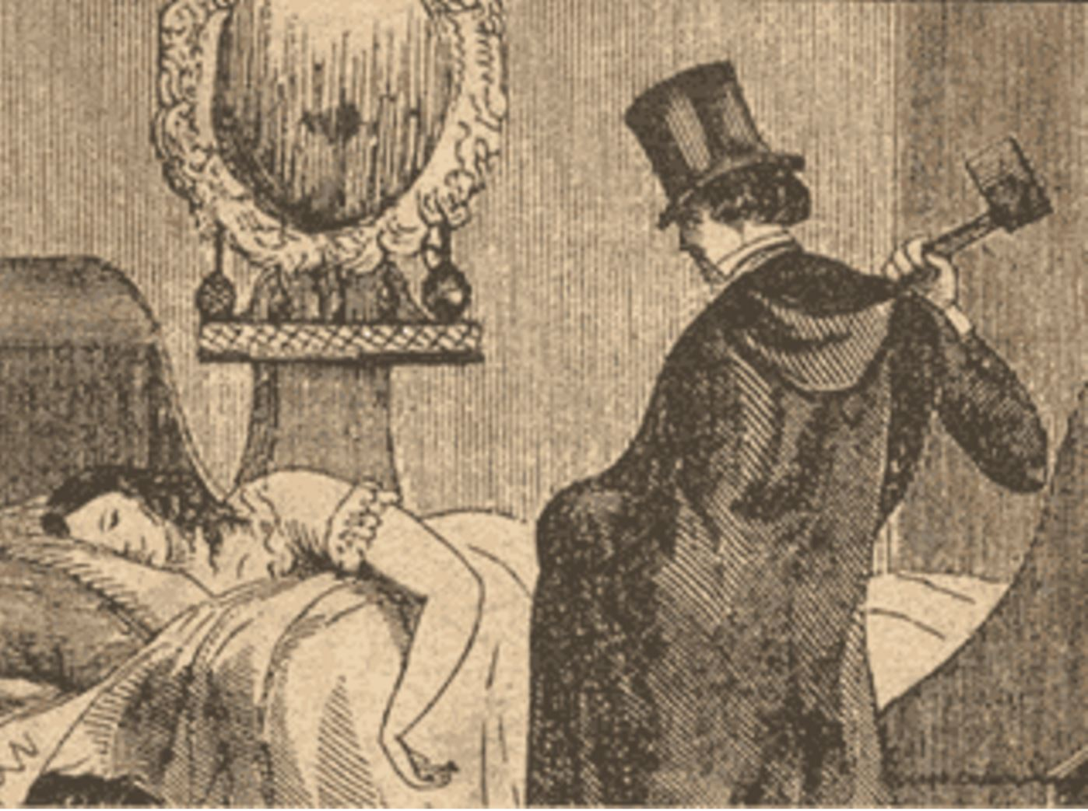
Review
Identify the following image and give the larger significance:
The Murder of Helen Jewett April 10, 1836. The gruesome murder of Dorcas Doyer, the high class New York prostitute known as Helen Jewett became a national sensation, made popular by the new penny press. It stood at the intersection of several shifts in American life—the shift from agrarian to urban, coming of age in the city and the demands life in the new republic had on the lives of women.

Slide 4
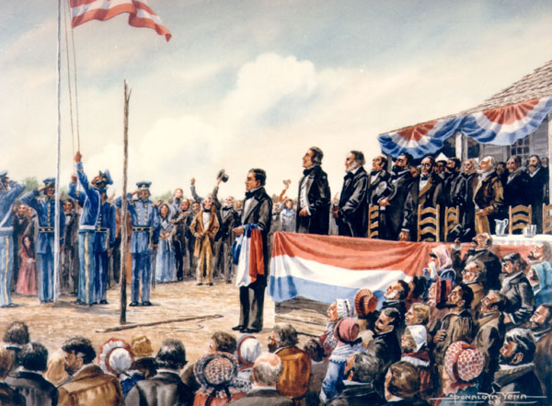
Review
empresario
An empresario, was an immigration agent who selected “moral colonists, distributed lands, and enforced regulations. Most U.S. citizens who settled in Mexico did so under an empresario who received nearly 25,000 acres of grazing land and 1,000 acres of farming land for every hundred families he settled. Between 1825 and 1832, approximately twenty-four empresario contracts (seventeen of which went to Anglo-Americans) were signed for eight thousand families. The land grants covered almost all of present-day Texas.
In 1826, an empresario named Hayden Edwards called for an independent Texas, the “Fredonia Republic.” Other empresarios, seeing advantages in peaceful relations with the Mexican government, resisted Edwards’s secessionist movement. Although the Fredonia revolt failed, Mexican authorities dreaded what it might foreshadow. Among white Texans, some, like Stephen Austin, favored staying in Mexico but demanded more autonomy, the legalization of slavery, and free trade with the United States. Others pushed for Texas secession from Mexico and wanted annexation to the United States.
Fredonia Republic
Annexation of Texas
In 1844, President John Tyler, convinced there was a British abolitionist conspiracy, signed the Treaty of Annexation, an event that caused Mexico to sever diplomatic relations with United States.
Tyler, however, lacked the votes in the Senate to ratify the treaty, and it was defeated by a wide margin in June. Shortly before he left office, Tyler tried again, this time through a joint resolution of both houses of Congress. With the support of President-elect Polk, Tyler managed to get the joint resolution passed on March 1, 1845, and Texas was admitted into the United States on December 29.
The Annexation of Texas to the Union, painting by Donald M. Yena. Texas State Library and Archives Commission

Slide 5
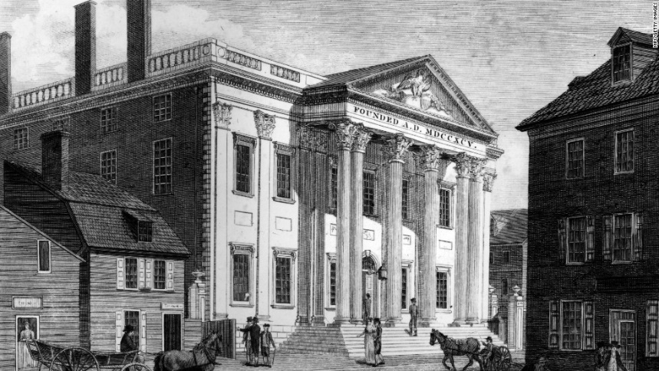
Review
South Carolina’s political leaders rejected the 1828 tariff, invoking the doctrine of nullification, maintaining that a state had the right to overrule, or nullify, federal legislation. Nullification borrowed from the 1798 Virginia and Kentucky Resolutions—that the states, representing the people, have a right to judge the constitutionality of federal actions. Jackson’s vice president, John C. Calhoun of South Carolina, argued in his unsigned Exposition and Protest that, in disagreements between federal and state governments, a special state convention should decide the conflict by either nullifying or affirming the federal law.
Nullification
Antimason Party
The Antimason Party was formed in upstate New York in the mid-1820s as a grassroots movement against Freemasonry, a secret male fraternity of prominent middle- and upper-class men. Evangelicals denounced Masonry, claiming its members neglected their families for alcohol and ribald entertainment. In the 1828 presidential election, the Antimasons opposed Jackson, a Mason.
In the 1830s, opponents of the Democrats, including remnants of the National Republican and Antimason parties, united as the Whig Party. From 1834 through the 1840s, Whigs and the Democrats competed on nearly equal footing, and each drew supporters from all regions. The era’s political competition—the second party system— thrived on ideological rivalry.
The two parties differed about the route to national prosperity. Democrats embraced westward expansion’s opportunities for independent landownership. Whigs were suspicious of rapid westward expansion, and instead pushed for commercial development within the nation’s current boundaries.
The Second Party System
The Second Bank of the United States

Slide 6
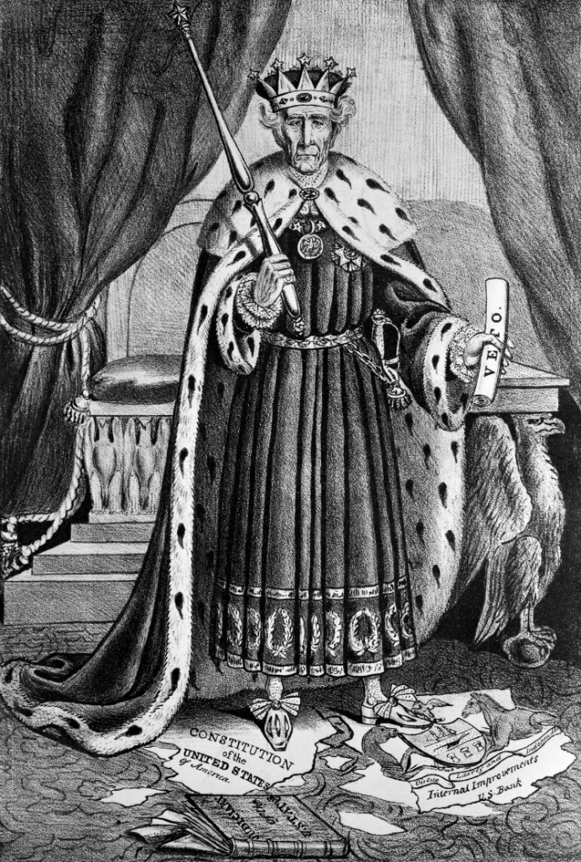
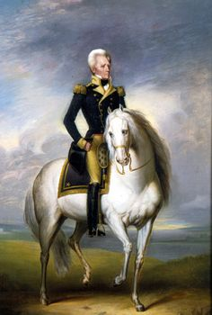
Review
Identify the following image and give the larger significance:
Left: Whigs, who named themselves after the loyal opposition in Britain, delighted in portraying Andrew Jackson as a power-hungry leader eager to turn a republic into a monarchy. Right: Even as his critics portrayed him as monarchical, Jackson presented himself as the president of the common man. Here he sits atop his prized horse, Sam Patch, named after the disgruntled factory worker and daring waterfall jumper.

Slide 7
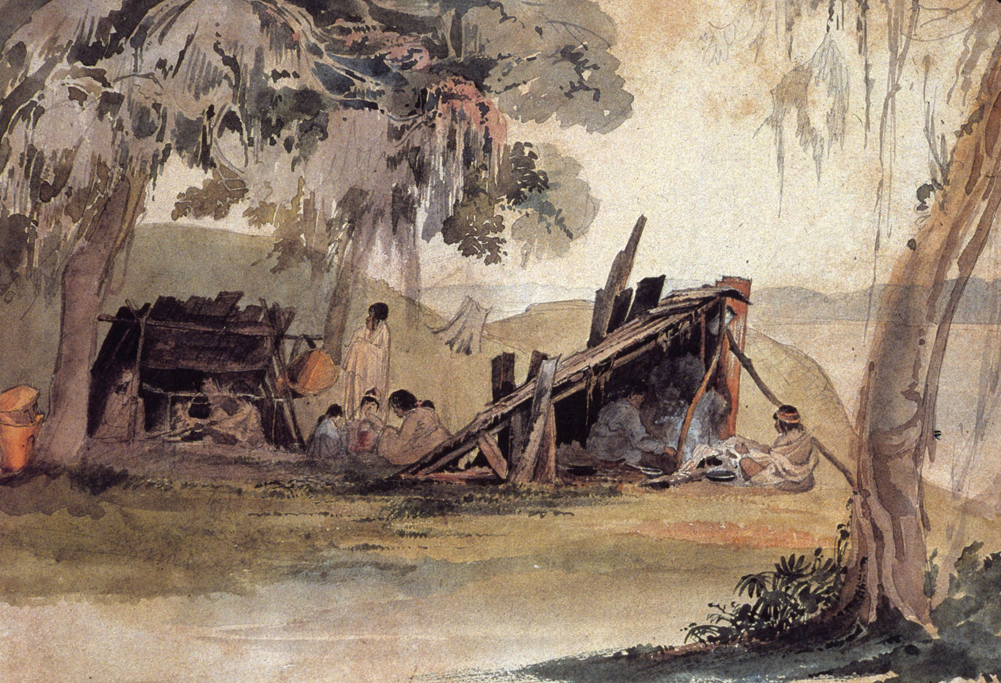
Review
Indian Removal Act
In 1830, after a narrow vote, Congress passed the Indian Removal Act authorizing the president to negotiate removal treaties with all tribes living east of the Mississippi. The bill, which provided federal funds for such relocations, would likely not have passed the House without the additional representation afforded slave states due to the Constitution’s three-fifths clause.
Name of the forced march made by the Cherokee and their slavesin the wake of the Indian Removal Act of 1830. After the United States signed the Treaty of New Echota with a minority of Cherokees who agreed to move west voluntarily. In 1838, citing the treaty federal troops rounded up most of the Cherokees, placed them in stockaded internment camps, and then relocated them across the Mississippi. About one quarter of the Cherokees died.
Trail of Tears
Seminole Wars
In Florida, some Seminole leaders agreed in the 1832 Treaty of Payne’s Landing to relocate to the West within three years, but others opposed the treaty. A minority, many composed of former runaways slaves who had become part of the Seminole nation under Osceola, a charismatic leader, fought the pro-treaty group. When federal troops were sent to impose removal in 1835, Osceola waged a guerrilla war against them.
Osceola was captured and died in an army prison in 1838, but the Seminoles fought on under Chief Coacoochee (Wild Cat). In 1842, the United States abandoned removal. Most of Osceola’s followers agreed to move west to Indian Territory after another war in 1858, but some remained in the Florida Everglades.
Southern Indians attempted to remain in their ancestral lands in the South. Karl Bodmer’s watercolor portrayed a Choctaw camp on the Mississippi River near Natchez, before the Indians were forced out of Mississippi and Alabama in 1830.

Slide 8
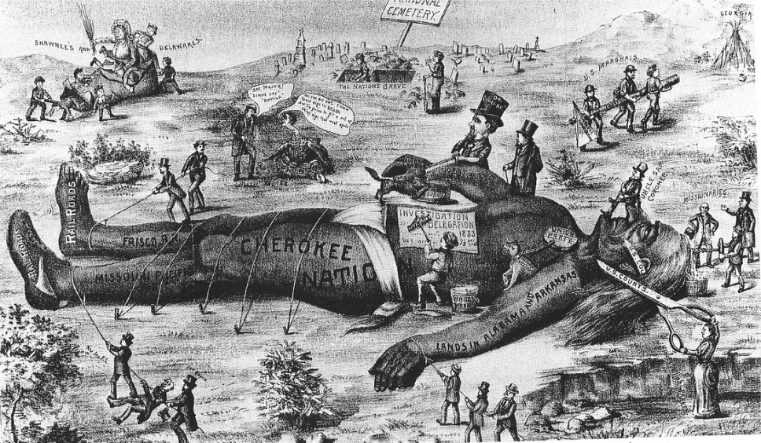
Review
Identify the following image and give the larger significance:
A cartoon lampooning Georgia after the case was decided by the U.S. Supreme Court. In the landmark case, The Cherokee Nation v. The State of Georgia, the United States Supreme Court ruled in 1831 that the Cherokee Indian Nation was not a foreign nation and therefore ruled that the Supreme Court did not have jurisdiction. The result was that the Cherokee Nation's land cessions were allowed to stand, and they were denied the right to sue in federal court to prevent their removal from tribal lands.

Slide 9
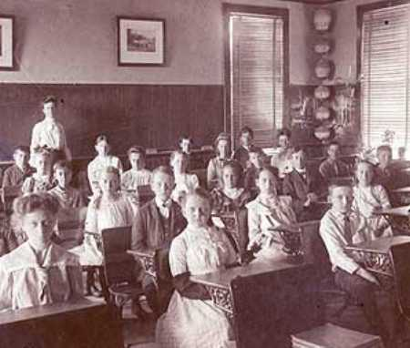
Review
The aftermath of an 1830 exposé of prostitution in New York City illustrates how reform led to political action. Even as female reformers organized a shelter for the city’s prostitutes and tried to secure respectable employment for them, they publicized the names of brothel clients to shame the men contributing to the women’s waywardness. New York women organized themselves into the Female Moral Reform Society, expanding their geographic scope and activities. For women and some men, reform represented their primary form of political influence at a time when the vote was restricted to property-owning men.
Female Moral Reform Society
Investigating asylums, petitioning the Massachusetts legislature, and lobbying other states and Congress, Dorothea Dix moved from reform to politics and helped create a new public role for women. In response to Dix’s efforts, twenty-eight of thirty-three states built public institutions for the mentally ill by 1860.
Dorthea Dix
Common School Movement
From 1837 to 1848, Massachusetts led the “common school” movement, establishing schools for training teachers (the “normal school,” modeled on the French école normale, and the forerunner of teacher-training colleges); lengthening the school year; and raising teachers’ salaries to make the profession more attractive.
The movement’s leader was Horace Mann, a Massachusetts lawyer and reformer from humble beginnings. Mann advocated free, tax-supported education to replace church schools and the private schools set up by untrained, itinerant young men. Universal education, Mann proposed, would end misery and crime, and would help Americanize immigrants.
Horace Mann’s education reform movement helped to educate women, resulting in rising numbers of women attending college.

Slide 10
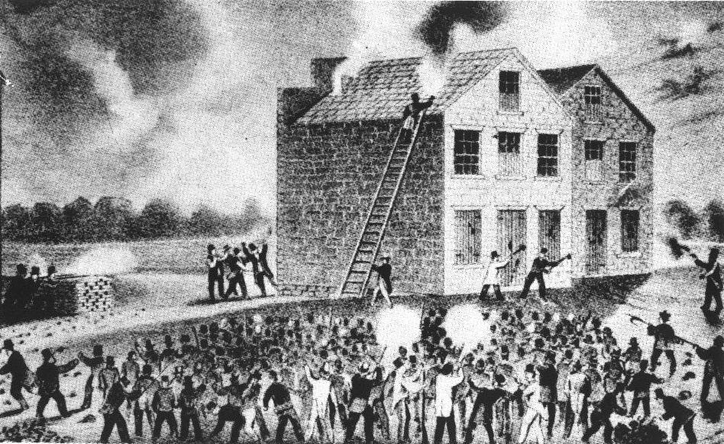
Review
Identify the following image and give the larger significance:
Wood engraving of proslavery riot in Alton, Illinois on November 7, 1837, which resulted in the murder of Elijah P. Lovejoy. White northerners had their own reasons for opposing abolition: they recognized cotton’s vital economic role, and they feared emancipation would prompt an enormous influx of freed slaves into their own region.

Slide 11
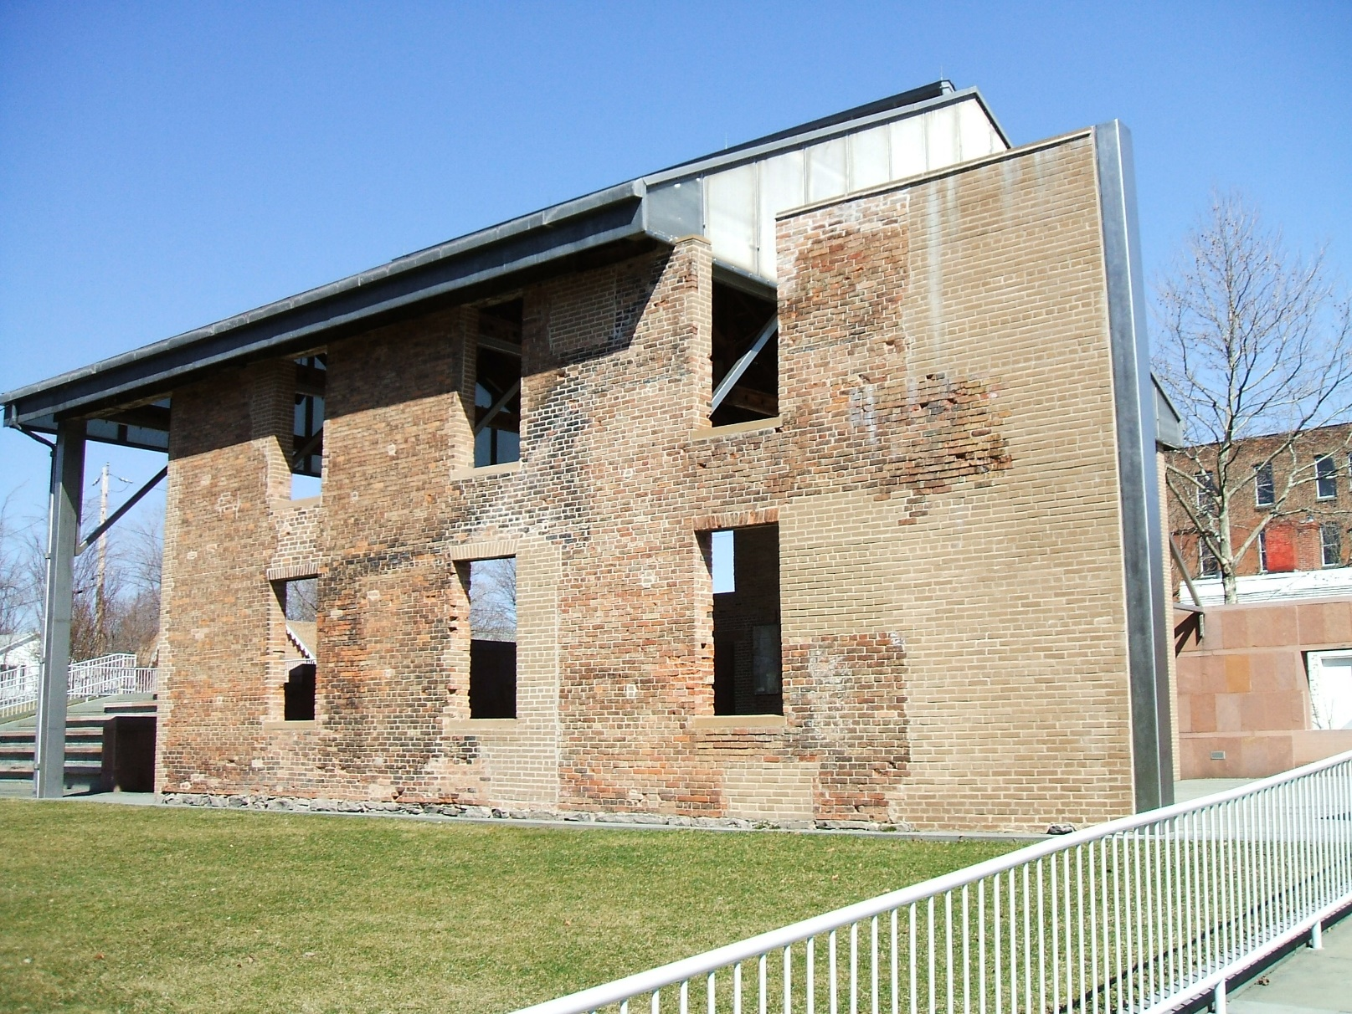
Review
Brook Farm
The most famous Fourier community was Brook Farm, in West Roxbury, Massachusetts, near Boston. Inspired by transcendentalism—the belief that the physical world is secondary to the spiritual realm, which human beings can reach not by custom and experience but only by intuition—Brook Farm’s members rejected materialism. Their rural communalism combined spirituality, manual labor, intellectual life, and play.
A literary outpouring known today as the American Renaissance, inspired in the 1830s by Ralph Waldo Emerson, a pillar of the transcendental movement. Widely admired, Emerson’s notions of individualism and self-reliance, influenced Hawthorne, Margaret Fuller, Herman Melville, and Thoreau, among many others. philosophical intensity and moral idealism, the American Renaissance was both distinctively American and an outgrowth of the European romantic movement. It addressed universal themes using American settings and characters. Hawthorne, for instance, used Puritan New England as a backdrop, and Melville wrote of great spiritual quests as seafaring adventures.
American Renaissance
First Woman’s Rights Convention at Seneca Falls
In July 1848 Elizabeth Cady Stanton, Lucretia Mott, Mary Ann McClintock, Martha Wright, and Jane Hunt—all abolitionists and all, except Stanton, Quakers—organized the first Woman’s Rights Convention at Seneca Falls, New York.. But the Seneca Falls convention addressed national, not just state, citizenship, and it drew more attention—and rancor.
At Seneca Falls, three hundred women and men demanded women’s social and economic equality, and some advocated political equality, too. They protested women’s legal disabilities and their social restrictions, such as exclusion from many occupations. Their Declaration of Sentiments, modeled on the Declaration of Independence, broadcast the injustices suffered by women and launched the women’s rights movement.
The remains of the Wesleyan chapel site of the Seneca Falls Convention

Slide 12
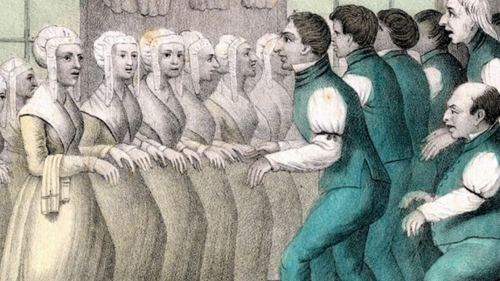
Review
Identify the following image and give the larger significance:
Although founded in the 18th century, the Shakers nevertheless enjoyed a heyday in the 19th spanning numerous settlements across the United States, attracting converts and adopting infants and children who were left in their care. Shakers practiced celibacy and communal ownership of goods, along with a strict separation of the sexes in both work and life.

Slide 13
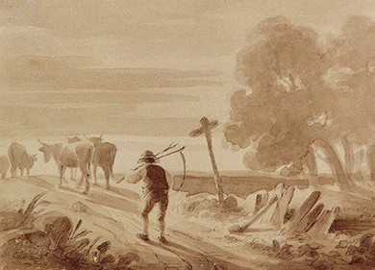
Review
Southern yeoman farmer
After the War of 1812, white farmers moved in waves down the southern Appalachians into the Gulf lands or through the Cumberland Gap into Kentucky and Tennessee. In large sections of the South, especially inland from the coast and away from large rivers, small, self-sufficient farms were the norm. Self-reliant and often isolated, they operated both apart from and within the slave-based staple-crop economy. On the southern frontier, men cleared fields, built log cabins, and established farms while their wives labored in the household economy.
After 1820, the heart of cotton cultivation and the slave-based plantation system shifted from the coastal states to Alabama and the newly settled Mississippi Valley—Tennessee, Louisiana, Arkansas, and Mississippi. Between 1820 and 1860, an estimated 2 million slaves were moved into the region extending from western Georgia to eastern Texas. Thousands of black families were disrupted every year to serve the needs of the expanding cotton economy.
The Domestic Slave Trade
The pushing system
Southern slave entrepreneurs created a complex of labor control practices that enslaved people called “the pushing system.” This system increased the number of acres of cotton each enslaved individual was compelled to cultivate. Innovation in violence, specifically the use of the bullwhip versus the cat-o’-nine-tails (a short leather whip with multiple tongs) extracted the maximum amount of output from enslaved people, at a high human cost. The amount of cotton the South grew increased almost every single year from 1800, when enslaved African Americans made 1.4 million pounds of cotton, to 1860, when they harvested almost 2 billion pounds.
Felix Octavious Carr Darley painting of yeoman farmer carrying a scythe and following livestock down the road.

Slide 14
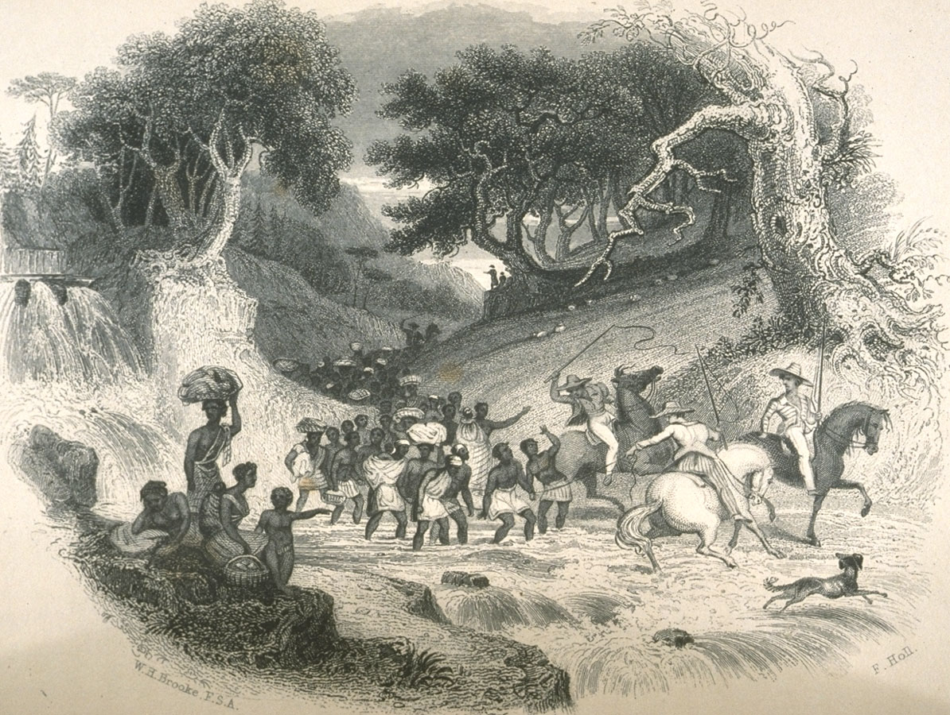
Review
Identify the following image and give the larger significance:
Slave coffle Washington DC ca 1819. This coffle was on the march toward the newly settled states of the Southwest.

Slide 15
Review
empresario
An empresario, was an immigration agent who selected “moral colonists, distributed lands, and enforced regulations. Most U.S. citizens who settled in Mexico did so under an empresario who received nearly 25,000 acres of grazing land and 1,000 acres of farming land for every hundred families he settled. Between 1825 and 1832, approximately twenty-four empresario contracts (seventeen of which went to Anglo-Americans) were signed for eight thousand families. The land grants covered almost all of present-day Texas.
In 1826, an empresario named Hayden Edwards called for an independent Texas, the “Fredonia Republic.” Other empresarios, seeing advantages in peaceful relations with the Mexican government, resisted Edwards’s secessionist movement. Although the Fredonia revolt failed, Mexican authorities dreaded what it might foreshadow. Among white Texans, some, like Stephen Austin, favored staying in Mexico but demanded more autonomy, the legalization of slavery, and free trade with the United States. Others pushed for Texas secession from Mexico and wanted annexation to the United States.
Fredonia Republic
Annexation of Texas
In 1844, President John Tyler, convinced there was a British abolitionist conspiracy, signed the Treaty of Annexation, an event that caused Mexico to sever diplomatic relations with United States.
Tyler, however, lacked the votes in the Senate to ratify the treaty, and it was defeated by a wide margin in June. Shortly before he left office, Tyler tried again, this time through a joint resolution of both houses of Congress. With the support of President-elect Polk, Tyler managed to get the joint resolution passed on March 1, 1845, and Texas was admitted into the United States on December 29.
The Annexation of Texas to the Union, painting by Donald M. Yena. Texas State Library and Archives Commission

Slide 16
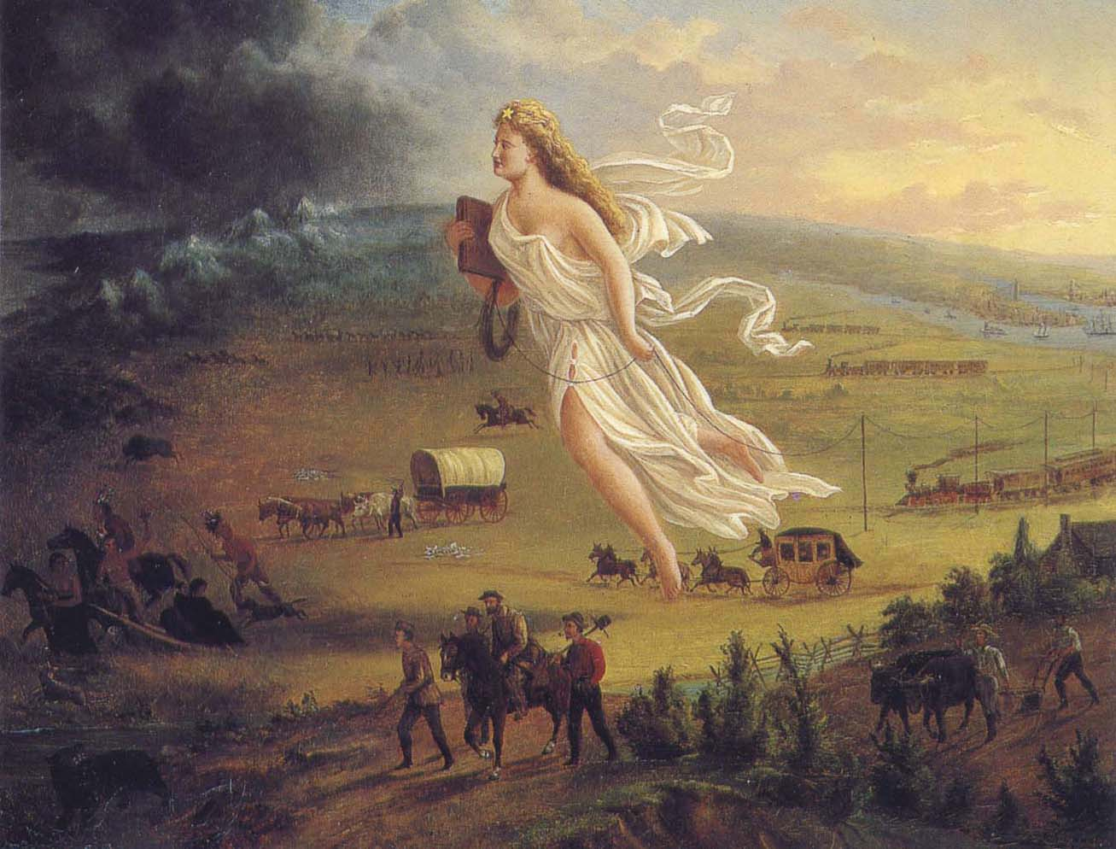
Review
Identify the following image and give the larger significance:
1872 painting by John Gast entitled American Progress depicts Columbia striding west bringing light to the darkness, technological progress and education. This image is an example of the concept of manifest destiny which was the belief that the United States was endowed by God with a mission to spread its republican government, Christian faith and freedom to less fortunate and uncivilized peoples.

Slide 17
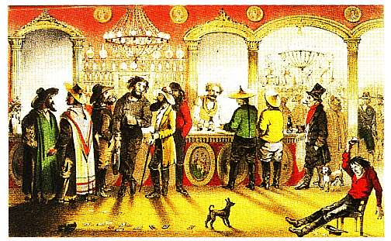
Review
Chicago commodities market
By the mid-nineteenth century, Chicago, with its railroads, stockyards, and grain elevators, dominated the region’s economy; western farmers transported livestock and grain by rail to that city, where pigs became packed meat and grain became flour before being shipped east. The promise of future flour and pigs gave rise to commodities markets. Some of the world’s most sophisticated and speculative economic practices took place in Chicago.
In what way was walking the overland trail a “race to safety”
Pioneer families left the Midwest as soon as the warmth of spring gave them dry ground to travel over, crossed the broad middle of the continent at the height of the summer, and—they hoped—reached the temperate climates of the Pacific before the first snows of winter closed the mountain passes. There was little room for error. The 1846 tragedy of the Donner Party exemplifies how falling behind on the trail could have disastrous consequences.
In what way was walking the overland trail a “race to safety”?
How did the gold rush transform Californian society?
How did the gold rush transform Californian society?
After an American carpenter discovered gold in the foothills of California’s boats turned river settlements like Louisville and Cincinnati into commercial Sierra Nevada range in 1848, Americans and people from around the world moved to California to look for gold.
With hungry gold miners to feed, California experienced an agricultural boom. Wheat became the preferred crop: it required minimal investment, was easily planted, and had a short growing season. California’s large-scale wheat farming depended on bonded Indian laborers.
Cities sprang up. In 1848, San Francisco was a small mission settlement of about 1,000 Mexicans, Anglos, soldiers, friars, and Indians. With the gold rush, it became a city, ballooning to 35,000 people in 1850. It was the West Coast gateway to the interior, and ships bringing people and supplies jammed the harbor.
This 1855 Frank Marryat drawing of a San Francisco saloon dramatizes the international nature of the California gold rush. Like theater performers, the patrons of the saloon dress their parts as Yankees, Mexicans, Asians, and South Americans.

Slide 18
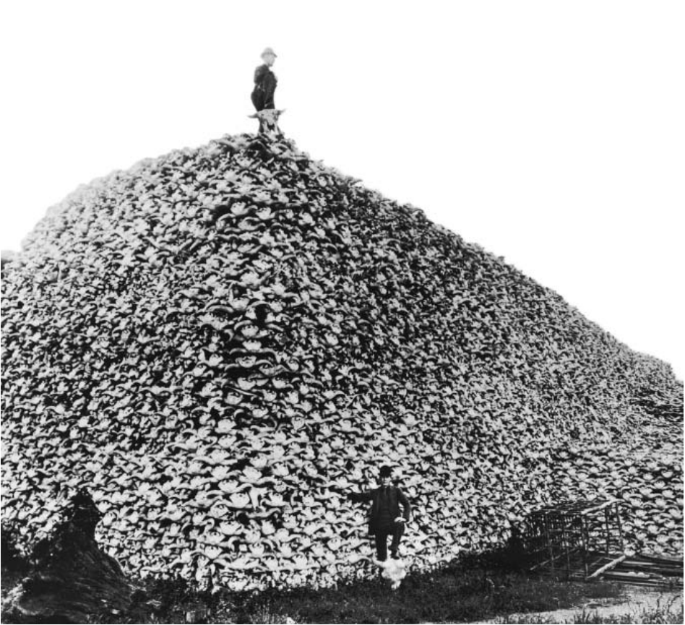
Review
Identify the following image and give the larger significance:
Buffalo Skulls to be Sold as Fertilizer, c. 1880: The slaughter of the buffalo herds in the late nineteenth century struck at the core of Plains Indian life. The buffalo provided protein to Plains Indians and held spiritual significance. Many Native Americans blamed the migrants for the buffalo’s disappearance.
By the time the overland migration peaked in the late 1840s and the 1850s, the herds were long overhunted, partly by Native Americans eager to trade their hides in the booming fur trade. The surviving buffalo scattered to where the grass was safe from the overlanders’ livestock. On rare occasions when wagon trains stumbled upon bison herds, men rushed to fulfill their frontier fantasies and shot the animals.

Slide 19
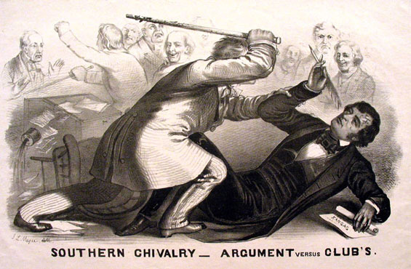
Review
Compromise of 1850
The compromise had five essential measures: 1.California became a free state. 2.The Texas boundary was set at its present limits and the United States paid Texas $10 million in compensation for the loss of New Mexico Territory. 3.The territories of New Mexico and Utah were organized on a basis of popular sovereignty. 4. The fugitive slave law was strengthened.
5.The slave trade was abolished in the District of Columbia. The compromise had two flaws. The first concerned the ambiguity of popular sovereignty. Southerners insisted on no prohibition of slavery during the territorial stage, and northerners declared that settlers could bar slavery whenever they wished. The compromise allowed for the appeal of a territorial legislature’s action to the Supreme Court.
The Kansas-Nebraska Act spawned violence as land-hungry partisans clashed in Kansas Territory. Abolitionists and religious groups sent armed Free-Soil settlers; southerners sent reinforcements to establish slavery and prevent “northern hordes” from stealing Kansas. Conflicts led to bloodshed, and soon the nation was talking about “Bleeding Kansas.”
Bleeding Kansas
What reason / reasons did secession delegates give for breaking from the union?
Abraham Lincoln did not appear on the ballot in the ten deep south southern states, and his win reflected the political vulnerability of the section. Repeatedly secessionist delegates stressed independence as the only way to preserve white racial security and the slave system. Only secession, said Alabama commissioner Stephen Hale to the Kentucky legislature, could sustain the “heaven ordained superiority of the white over the black race.”
Lithograph of Preston Brooks’ 1856 attack on Sumner. Artist John L. Magee depicts the faceless assailant bludgeoning the learned martyr.

Slide 20
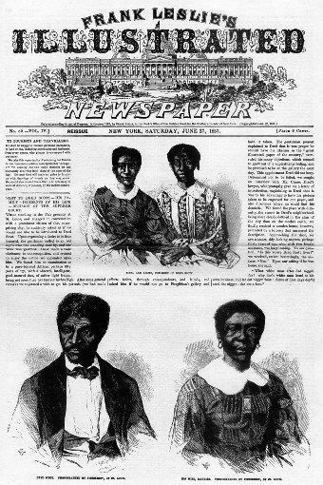
Review
Identify the following image and give the larger significance:
In Dred Scott v. Sandford, decided on March 6, 1857, Chief Justice Roger B. Taney ruled that African Americans, whether enslaved or free, could not be American citizens and therefore had no standing to sue in federal court. In addition Taney ruled that the federal government had no power to regulate slavery in the federal territories acquired after the creation of the United States. Dred Scott, an enslaved African American man had been taken by his owners to free territory and attempted to sue for his freedom.
The framers of the Constitution, Taney wrote, believed that blacks “had no rights which the white man was bound to respect; and that the negro might justly and lawfully be reduced to slavery for his benefit. He was bought and sold and treated as an ordinary article of merchandise and traffic, whenever profit could be made by it.“
In northern black communities, rage and despair prevailed. Many fugitive slaves sought refuge in Canada; others considered the Caribbean or Africa

Slide 21
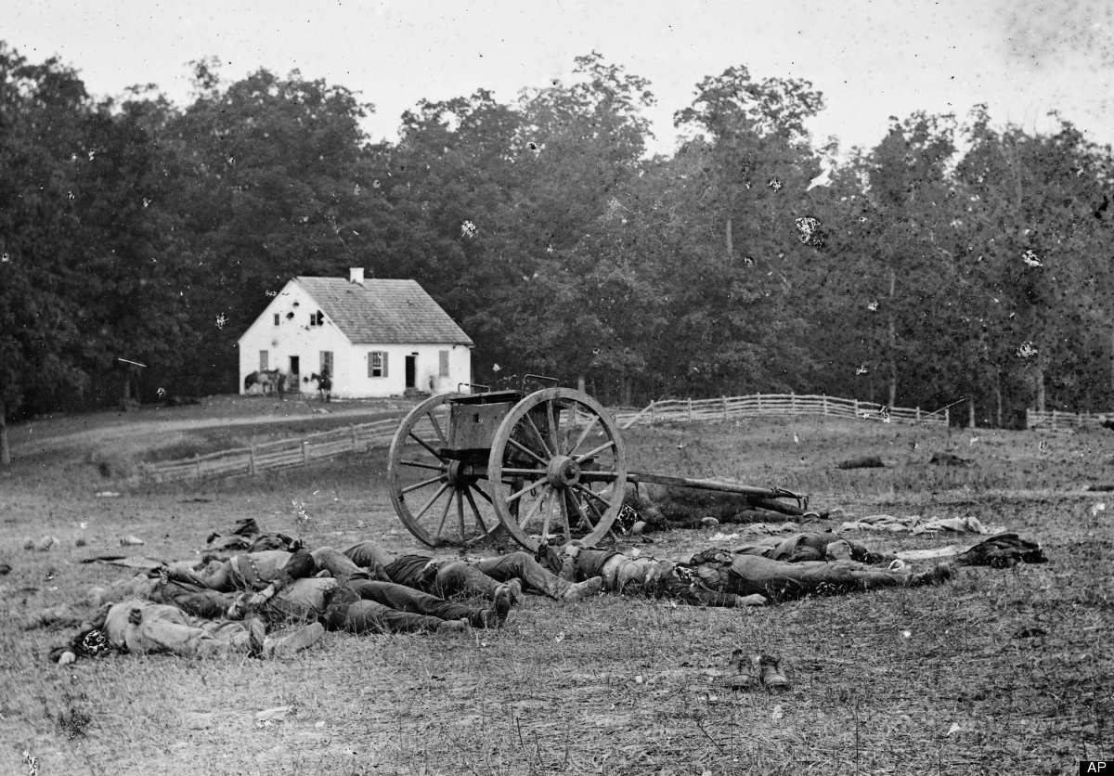
Review
Antietam
But in the bloodiest day of the war, September 17, 1862, the Battle of Antietam, five thousand men died, and another eighteen thousand were wounded. McClellan intercepted a battle order, wrapped around cigars for each Confederate corps commander and lost by a courier. But McClellan moved slowly, failed to use his larger forces in simultaneous attacks, and allowed Lee’s stricken army to retreat to across the Potomac. Lincoln removed McClellan from command.
How did Northern women’s lives change during the war?
They organized over ten thousand soldiers’ aid societies, rolled bandages, and raised $3 million to aid injured troops. Women pressed for the first trained ambulance corps in the Union army, and they formed the backbone of the U.S. Sanitary Commission, a civilian agency recognized by the War Department in 1861, which provided nutritional and medical aid to soldiers. Approximately thirty-two hundred women also served as nurses in front line hospitals.
Lincoln declared that “all persons held as slaves” in areas in rebellion “shall be then, thenceforward, and forever free.” But he excepted as areas in rebellion every Confederate county or city that had fallen under Union control. Those areas, he declared, “are, for the present, left precisely as if this proclamation were not issued.” Nor did Lincoln liberate slaves in the border slave states that remained in the Union.
Emancipation Proclamation
In October 1862 in New York City, photographer Matthew Brady opened an exhibition of photographs from the Battle of Antietam. Although few knew it, Brady’s vision was very poor ,and this photograph of Confederate dead was actually made by his Assistants, Alexander Gardner and James F. Gibson.

Slide 22
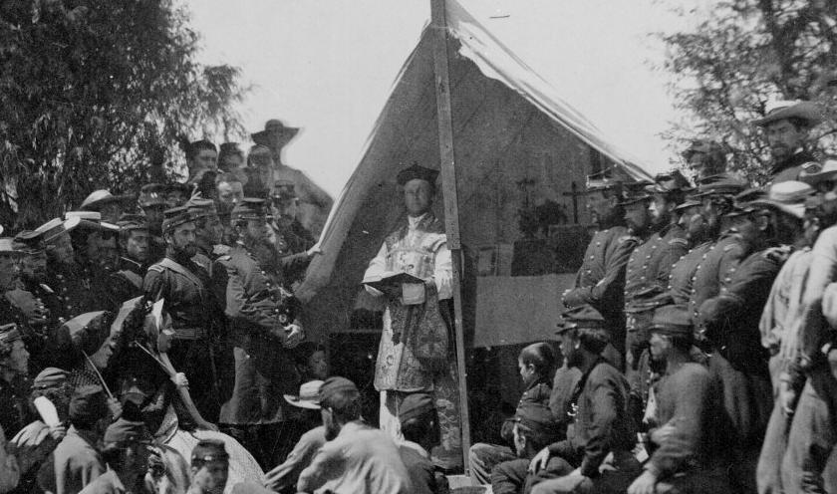
Review
Identify the following image and give the larger significance:
Both armies experienced religious revivals during the war. This photograph shows members of a largely Irish regiment from New York celebrating Mass at the beginning of the war. Notice the presence of some female visitors in the left foreground. Library of Congress

Slide 23
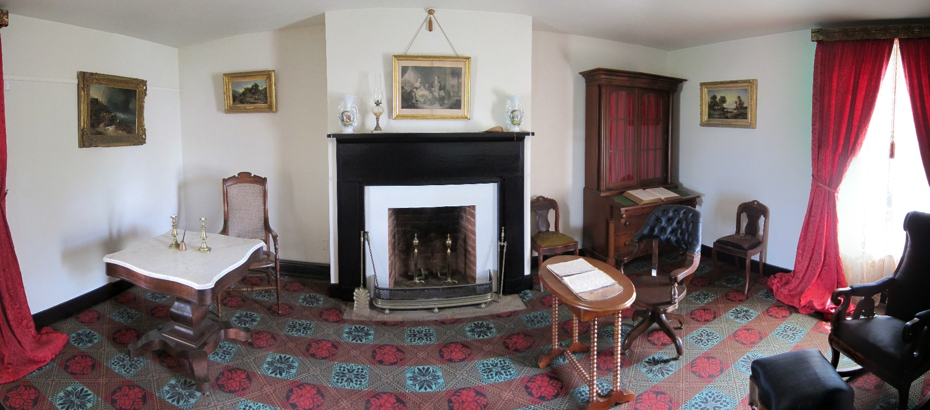
Review
New York City Draft Riots
On July 13, 1863, as the second day of a new military draft lottery in New York City got underway, demonstrations broke out across the city in what began as an organized opposition to the first federally mandated conscription laws in the nation’s history, but soon morphed into a violent uprising against the city’s wealthy elite; its African-American residents; and the very idea of the Civil War itself.
The New York City Draft Riots, which would wreak havoc on the city for four days and remain the largest civilian insurrection in American history, exposed the deep racial, economic and social divides that threatened to tear the nation’s largest city apart in the midst of the American Civil War.
Port Royal Experiment
The late historian of the American South, C. Vann Woodward called the Port Royal Experiment a “dress rehearsal for Reconstruction acted out on the stage neatly defined by the Sea Islands of South Carolina. In January of 1862 Union General Thomas W. Sherman requested teachers from the North to train the ex-slaves. Three months later U.S. Secretary of Treasury Salmon Chase appointed Boston attorney Edward L. Pierce to begin the Port Royal Experiment, which would create schools and hospitals for ex-slaves and to allow them to buy and run plantations.
Reconstructed parlor of the McLean House. Ulysses S. Grant sat at the simple wooden table on the right, while Robert E. Lee sat at the more ornate marble-topped table on the left.
On April 9, hemmed in by Union troops, short of rations, and with fewer than thirty thousand men left, he surrendered at Appomattox Court House. Grant treated his rival with respect and paroled the defeated troops, allowing cavalrymen to keep their horses and take them home. The North rejoiced, and most southerners fell into despair, expecting waves of punishment. In the profound relief and stillness of the surrender field at Appomattox, no one could know the harrowing tasks of healing and justice that lay ahead.
Appomattox

